Slide 1
Traditional ML vs Modern NLP
Transformers:
A Case Study on
Sentiment Analysis
SEMESTER PROJECT NLP

Slide 2
Mehvish Kiani

Slide 3
Project Objective
The main objective of this project is to evaluate and compare the effectiveness of traditional machine learning approaches (e.g., TF-IDF + Logistic Regression) with modern NLP models (e.g., BERT) for the task of text classification.
This includes analyzing:
Accuracy and performance differences
Resource usage (CPU vs. GPU)
Optimization trade-offs
Real-world applicability in constrained environments

Slide 4
_{Dataset Used}
01
Hugging Face datasets.load_dataset("imdb")
Source:
02
50,000 movie reviews labeled as positive or negative
Description
03
25,000 training and 25,000 testing examples
Split

Slide 5

_{Preprocessing}
Traditional (TF-IDF + Logistic Regression)
Modern (BERT)
Lowercased text
Removed stopwords/punctuation (optional)
Transformed text using TfidfVectorizer with max_features=5000
Used BertTokenizer from transformers
Tokenized with truncation and padding
Converted dataset into PyTorch format for Trainer

Slide 6
_{Results and Improvements}
Modern (BERT)
Traditional (TF-IDF + LR)
90%
90%
90%
90%
5 min(on GPU)
Accuracy
Precision
Recall
F1-Score
Training Time
82%
82%
82%
82%
1 min(on CPU)

Slide 7
Optimization Comparison (Traditional vs. Modern)
Aspect | Traditional (TF-IDF + LR) | Modern (BERT)
Accuracy | ✅ Higher (90%) | ❌ Lower (82%)
Training Time | ✅ Very Fast (seconds) | ❌ Slower (minutes)
Resource Usage | ✅ CPU only | ❌ Requires GPU
Model Size | ✅ Lightweight | ❌ Heavy (110M+ parameters)
Interpretability | ✅ High (feature weights) | ❌ Low (black-box model)
Fine-tuning Need | ✅ None | ❌ Needs careful fine-tuning
Aspect | Traditional (TF-IDF + LR) | Modern (BERT)

Slide 8
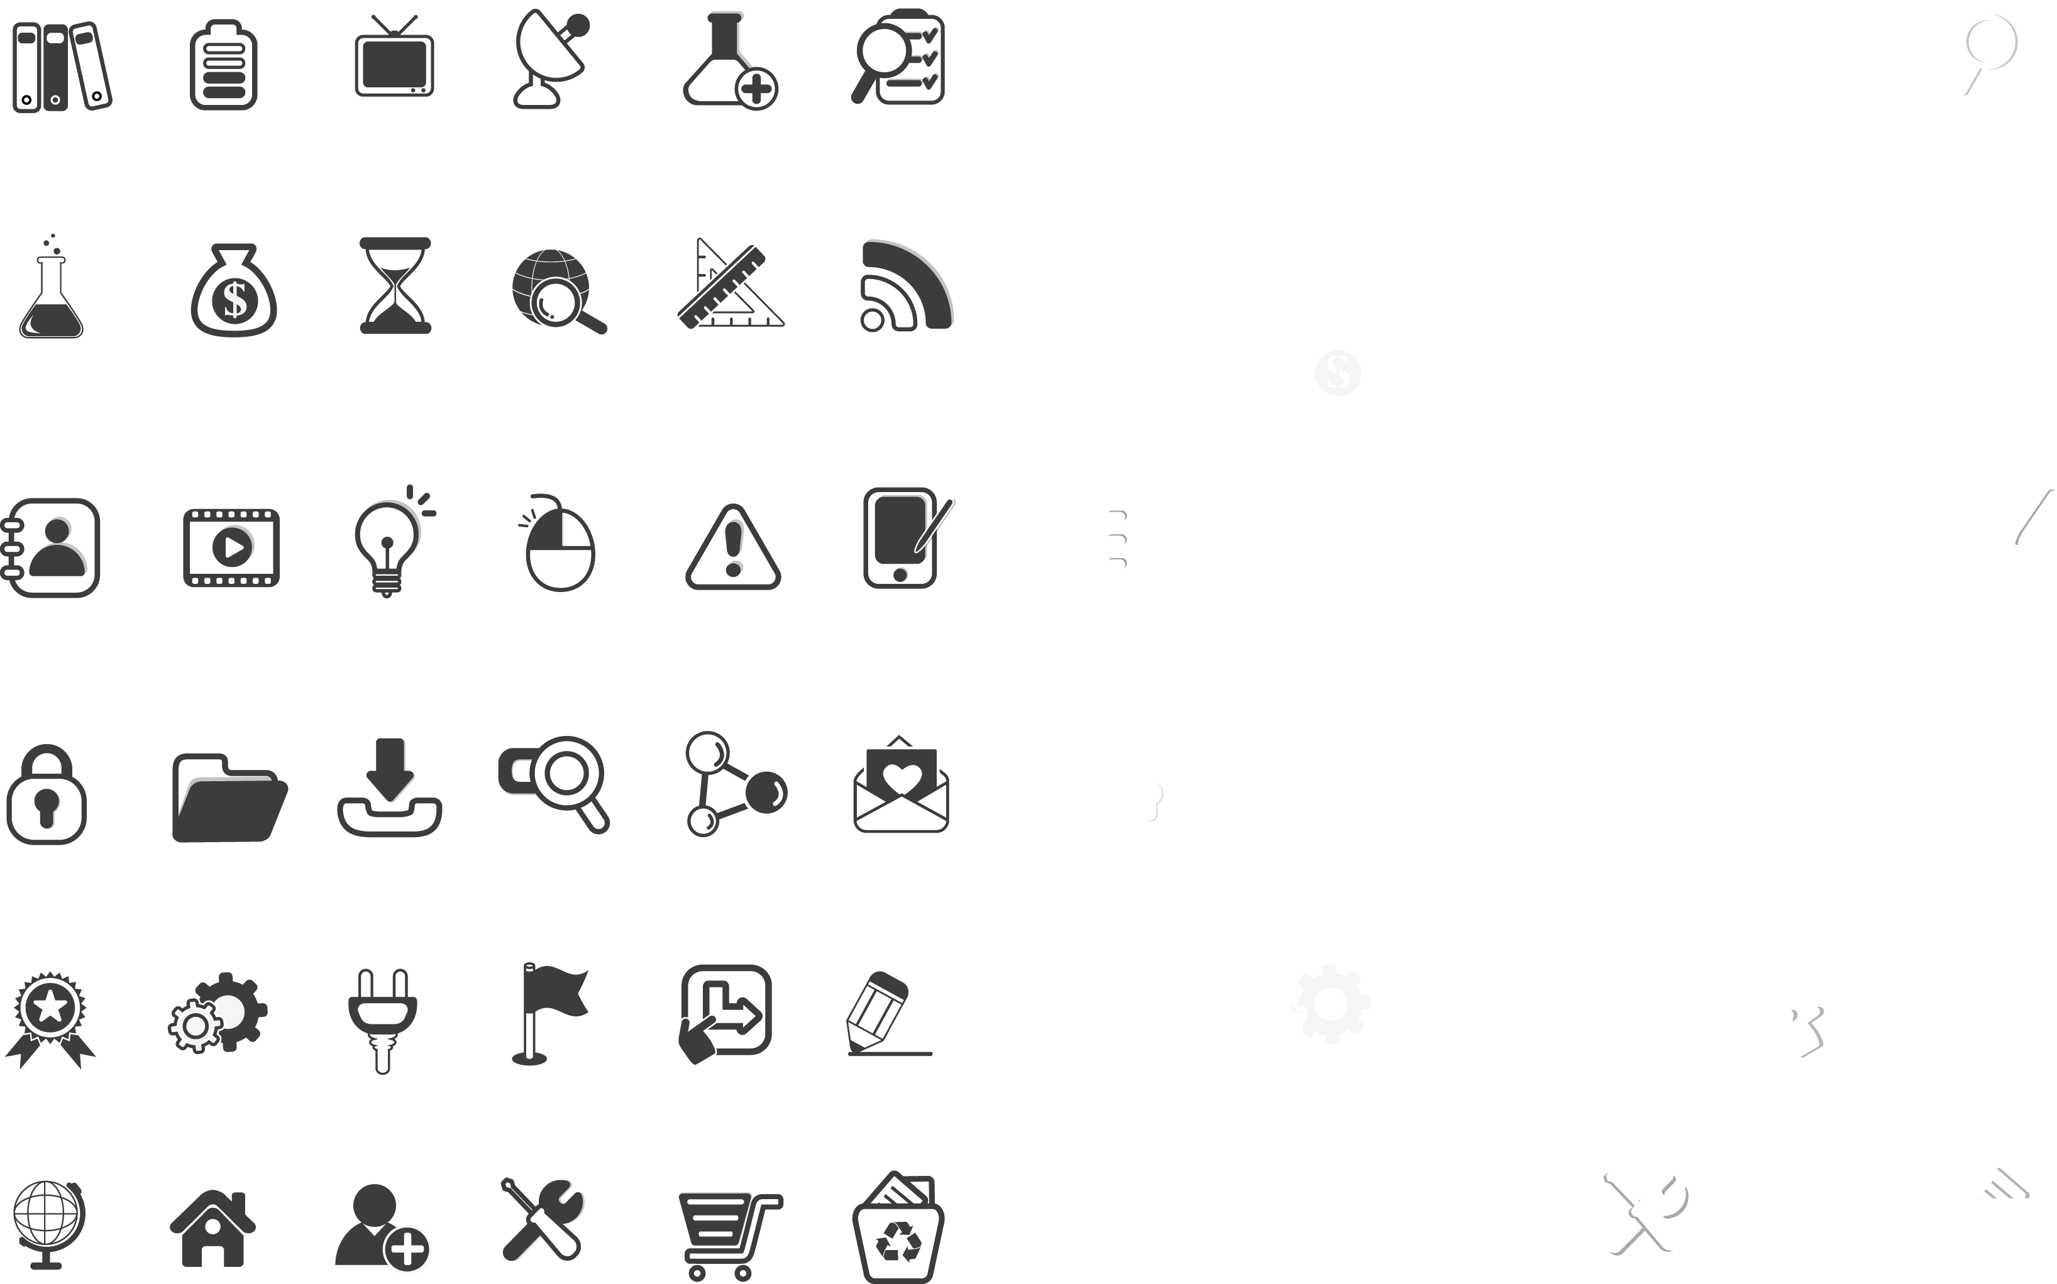
_{Challenges and Learnings}
Challenges Faced
BERT required significant GPU resources to train properly.
Fine-tuning BERT without overfitting was difficult on a limited dataset subset.
Managing token length and memory issues during transformer training.
Key Learnings
BERT required significant GPU resources to train properly.
Fine-tuning BERT without overfitting was difficult on a limited dataset subset.
Managing token length and memory issues during transformer training.
A
B
INSERT YOUR TEXT
C

Slide 9
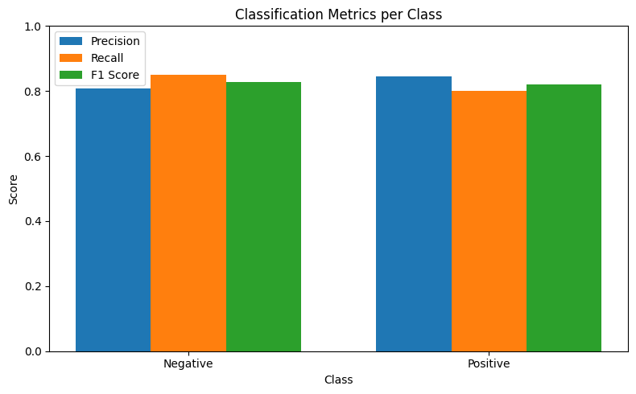
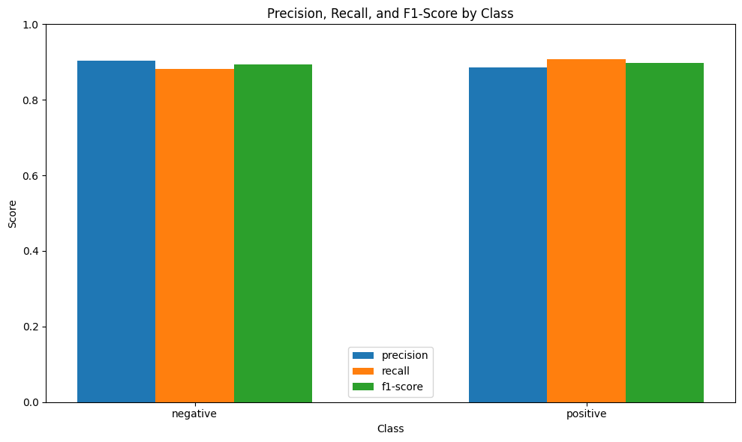
MODERN BERT vs Tradional ML

Slide 10
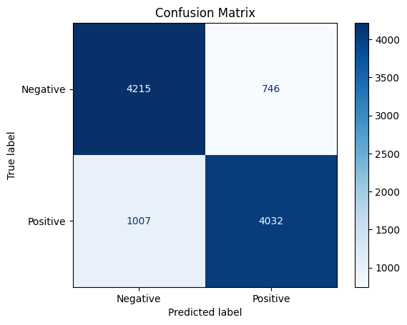
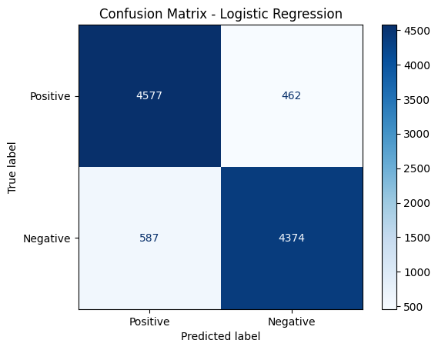
MODERN BERT VS Tradional ML

Slide 11
THANK YOU

